Slide 1
Speech Recognition Dataset Generation
Steeve Huang

Slide 2
Agenda
Recent progress
Problems

Slide 3
Recent Progress
Fix “middle detection” bug
Test Time Augmentation for Mask-RCNN
Generate SRT for comparison

Slide 4
Test Time Augmentation for Mask-RCNN
Horizontal Flip, Vertical Flip
Masks union

Slide 5
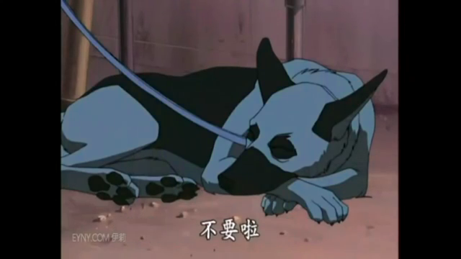
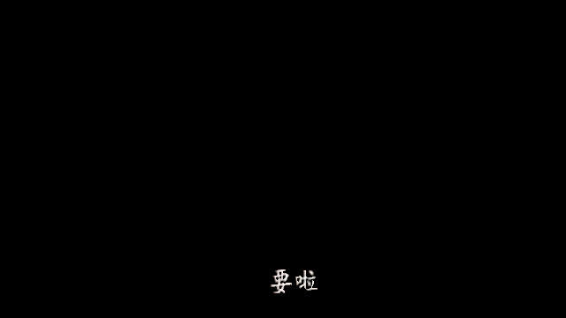
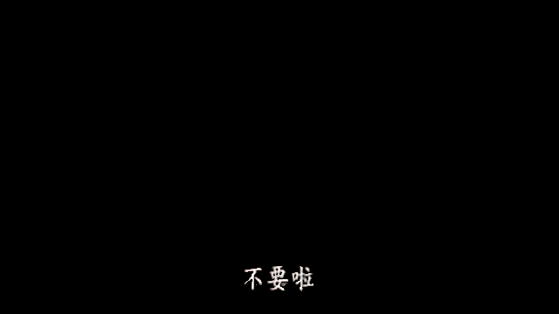
Test Time Augmentation for Mask-RCNN

Slide 6
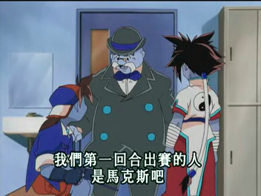
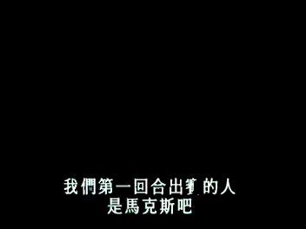
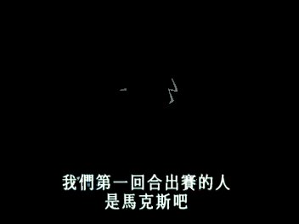
Test Time Augmentation for Mask-RCNN

Slide 7
Filter Empty Images Before Sending OCR Request
Sum of RGB values < THRESHOLD => do not send OCR request
Filter Rate: 24% (1308/ 5389)

Slide 8
Generate SRT for comparison

Slide 9
Challenge 1: Time Consuming
Inference time for Mask-rcnn is too long
Average time:
CPU: 5 seconds/ frame (80 cores)
GPU: 1 second/ frame (V100)

Slide 10
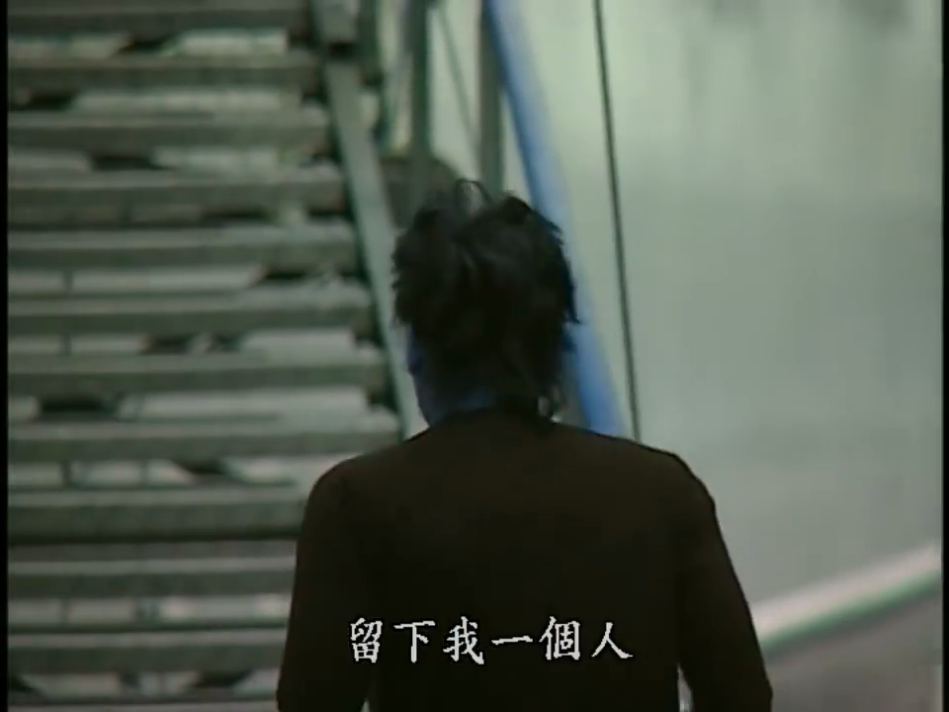
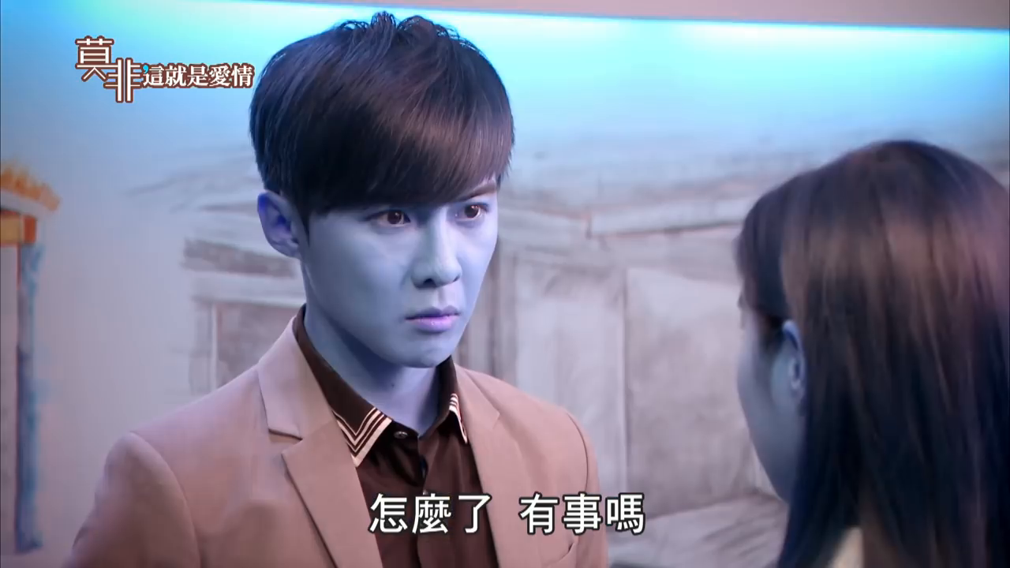
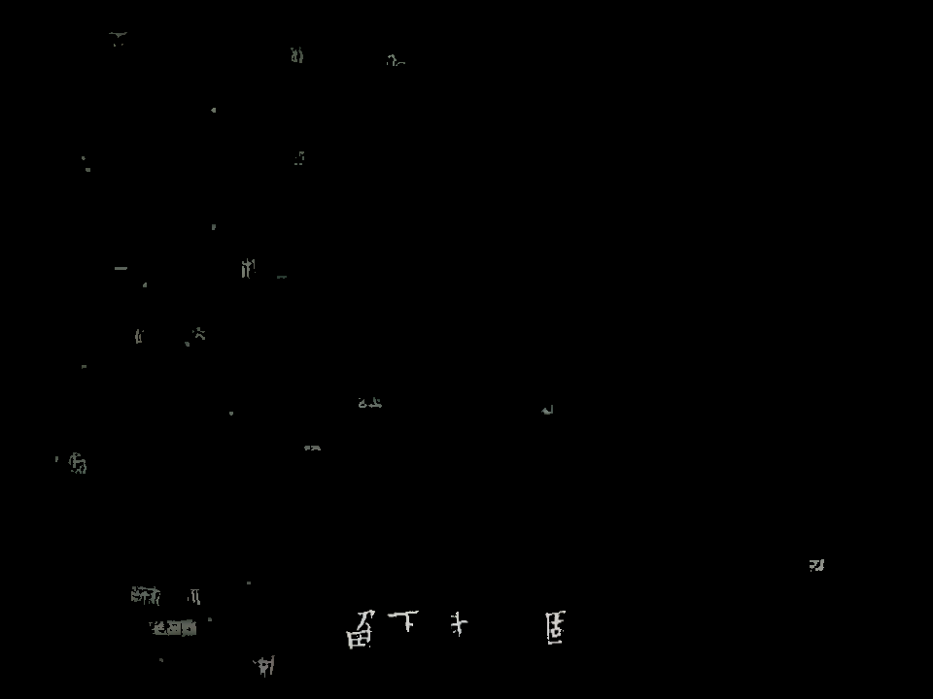
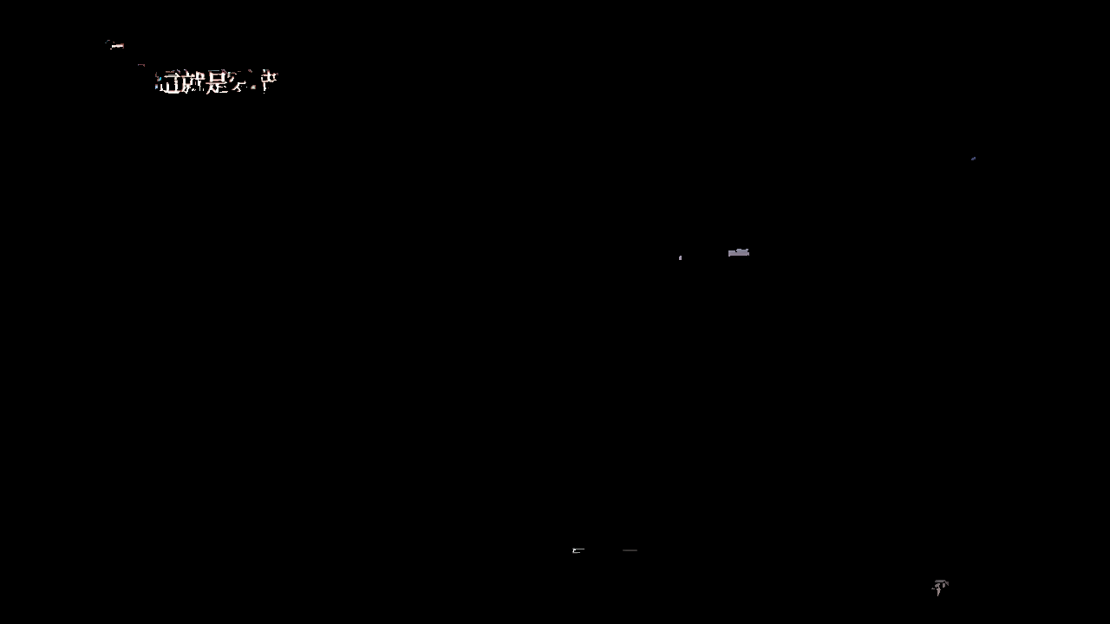
Challenge 2: Mask-RCNN failed for large images

Slide 11
Challenge 2: Mask-RCNN failed for large images
Retrain Mask-RCNN with
larger dataset
larger images
different loss functions

Slide 12
Next Step
Retrain Mask-RCNN
Improve Post-processing algorithms
Annotate a validation dataset

